Slide 2
Quan tam
0>Muc luc file PDF p9
1>Data and Database
2>file base system && database system
3>DBMS
4>RDBMS
5>Network data model
DDL,DML,DCL p22
6>Database Models p15
Flat-file Data Model
Hierarchical Data Model
Network Data Model
Relational Data Model
Term relate RDBMS
Entity p37
Difference of DBMS VS RDBMS p40
Summary p41

Slide 3
Objectives
Explain the concept of data and database
Describe the approaches to data management
Define a Database Management System (DBMS) and list its benefits
Explain the different database models
Define and explain RDBMS
Describe entities and tables and list the characteristics of tables
List the differences between a DBMS and an RDBMS

Slide 4
Introduction
Organizations often maintain large amounts of data, which are generated as a result of day-to-day operations.
A database:
is an organized form of such data.
may consist of one or more related data items called records.
is a data collection to which different questions can be asked.
For example,
'What are the phone numbers and addresses of the five nearest post offices?' or
'Do we have any books in our library that deal with health food?'

Slide 5
Data and Database
When this data is gathered and analyzed, it yields information. Intelligent interpretation of data yields information.
Information helps to foresee and plan events.
Following figure illustrates the concept of a database:
A database is an organized collection of data such that its contents can be easily accessed, managed, and updated.
A phone book is a database consisting of names, addresses, and telephone numbers.

Slide 6
Data Management
Data management deals with managing large amount of information, which involves:
the storage of information
the provision of mechanisms for the manipulation of information
providing safety of information stored under various circumstances
The two different approaches of managing data are as follows:
File-based systems
Database systems

Slide 7
File-based Systems
In a file-based systems data is stored in discrete files and a collection of such files is stored on a computer.
Files of archived data were called tables because they looked like tables used in traditional file keeping.
Rows in the table were called records and columns were called fields. An example of the file-based system is illustrated in the following table:
^{First Name} | ^{Last Name} | ^{Address} | ^{Phone}
Eric | David | ericd@eff.org | ²¹³⁻⁴⁵⁶⁻⁰⁹⁸⁷
Selena | Sol | ^{selena@eff.org} | ⁹⁸⁷⁻⁷⁶⁵⁻⁴³²¹
Jordan | Lim | nadroj@otherdomain.com | 222-3456-123

Slide 8
Disadvantages of File-based Systems
Data redundancy and inconsistency
Unanticipated queries
Data isolation
Integrity problems
Concurrent access anomalies
Security problems
Notes:
Anomaly: bất thường
Integrity: toàn vẹn

Slide 9
Database Systems
Database Systems evolved in the late 1960s to address common issues in applications handling large volumes of data, which are also data intensive.
Databases are used to store data in an efficient and organized manner. A database allows quick and easy management of data.
At any point of time, data can be retrieved from the database, added, and searched based on some criteria in these databases.
Data storage can be achieved even using simple manual files.
Data stored in this form is not permanent. Records in such manual files can only be maintained for a few months or few years.
Notes:
Evolve : phát triển
Intensive: chuyên sâu, thiên về
Achieve: đạt được

Slide 10
Advantages of Database Systems
The amount of redundancy in the stored data can be reduced
No more inconsistencies in data
The stored data can be shared
Security of data can be implemented
Standards can be set and followed
Data Integrity can be maintained
Notes:
Maintain: duy trì

Slide 11
Database Management System (DBMS) 1-2
A DBMS is a collection of related records and a set of programs that access and manipulate these records and enables the user to enter, store, and manage data.
In a centralized database system, the database is stored in the central location which everybody can have access from their machine.
A database is a collection of interrelated data, and a DBMS is a set of programs used to add or modify this data.
Examples of database applications include:
Computerized library systems
Automated teller machines
Flight reservation systems
Computerized parts inventory systems
Notes:
Interrelate: tương tác với nhau.
Automated teller machine : máy rút tiền tự động

Slide 12
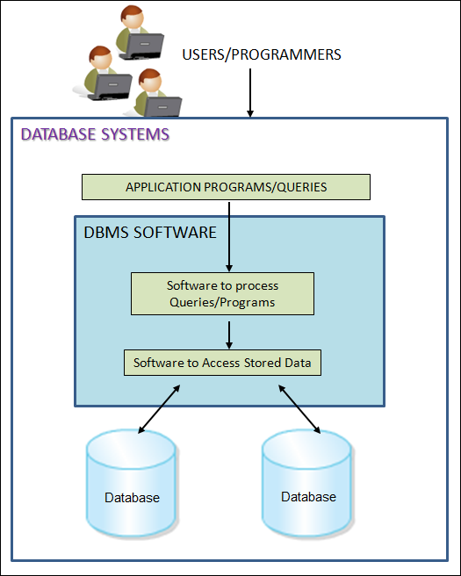
Database Management System (DBMS) 2-2
Following figure illustrates a database system:

Slide 13
Benefits of DBMS 1-2
A DBMS is responsible for processing data and converting it into information.
A database for this purpose has to be manipulated, which includes querying the database to retrieve specific data, updating the database, and finally, generating reports.
These reports are the source of information, which is, processed data.
A DBMS is also responsible for data security and integrity.

Slide 14
Benefits of DBMS 2-2
Data storage
Data definition
Data manipulation
Performance optimization
Data security and integrity ( toàn vẹn)
Data recovery and concurrency (khôi phục dữ liệu và …)
Database access languages and Application Programming Interfaces (APIs)
Multi-user access control

Slide 15
Database Models
Databases can be differentiated based on functions and model of the data.
A data model describes a container for storing data, and the process of storing and retrieving data from that container.
The analysis and design of data models has been the basis of the evolution of databases.
Each model has evolved from the previous one. The commonly used Database Models are as follows:
Flat-file Data Model
File phẳng
Hierarchical Data Model
File phân cấp hình cây
Network Data Model
File mạng
Relational Data Model
File mô hình quan hệ

Slide 16
Flat-file Data Model
In this model, the database consists of only one table or file.
This model is used for simple databases - for example, to store the roll numbers, names, subjects, and marks of a group of students.
This model cannot handle very complex data. It can cause redundancy when data is repeated more than once.
Following table depicts the structure of a flat file database:
^{Roll Number} | ^{First Name} | ^{Last Name} | ^{Subject} | ^{Marks}
45 | Jones | Bill | Maths | ⁸⁴
45 | Jones | Bill | ^{Science} | ⁷⁵
50 | Mary | Mathew | ^{Science} | ⁸⁰

Slide 17
Hierarchical Data Model 1-3
In this model, different records are inter-related through hierarchical or tree-like structures.
In this model, relationships are thought of in terms of children and parents.
A parent record can have several children, but a child can have only one parent.
To find data stored in this model, the user needs to know the structure of the tree.
Windows Registry is an example of a hierarchical database storing configuration settings and options on Microsoft Windows operating systems.

Slide 18
Hierarchical Data Model 2-3
Following figure illustrates an example of a hierarchical representation:
Within the hierarchical model, Department is perceived as the parent of the segment.
The tables, Project and Employee, are children.
A path that traces the parent segments beginning from the left, defines the tree.
This ordered sequencing of segments tracing the hierarchical structure is called the hierarchical path.
Notes:
Perceive: được xem như là

Slide 19
Hierarchical Data Model 3-3
The advantages of a hierarchical model are as follows:
Data is held in a common database so data sharing becomes easier, and security is provided and enforced by a DBMS.
Data independence is provided by a DBMS, which reduces the effort and costs in maintaining the program.
This model is very efficient when a database contains a large volume of data.
For example, a bank's customer account system fits the hierarchical model well because each customer's account is subject to a number of transactions.

Slide 20
Network Data Model 1-4
This model is similar to the Hierarchical Data Model. It is actually a subset of the network model.
In the network model, data is stored in sets, instead of the hierarchical tree format. This solves the problem of data redundancy.
The set theory of the network model does not use a single-parent tree hierarchy. It allows a child to have more than one parent. Thus, the records are physically linked through linked-lists.
For every database, a definition of the database name, record type for each record, and the components that make up those records is stored. This is called its network schema.
A portion of the database as seen by the application's programs that actually produce the desired information from the data contained in the database is called sub-schema.
It allows application programs to access the required data from the database. Raima Database Manager (RDM) Server by Raima Inc. is an example of a Network DBMS.

Slide 21
Network Data Model 2-4
The network model shown in the following figure illustrates a series of one-to-many relationships:
A sales representative may write many Invoice tickets, but each Invoice is written by a single Sales representative (Salesrep).
A Customer might make purchases on different occasions.
A Customer may have many Invoice tickets, but each Invoice belongs only to a single customer.
An Invoice ticket may have many Invoice lines (Invline), but each Invline is found on a single Invoice ticket.
A Product may appear in several different Invline, but each Invline contains only a single Product.

Slide 22
Network Data Model 3-4
The components of the language used with network models are as follows:
(DQL: select)
Data Definition Language (DDL)
Sub-schema DDL
Data Manipulation Language (DML)
Data Control Language (DCL)
Used to create and remove databases and database objects. It enables the database administrator to define the schema components.(create ,alert,drop,rename,truncate,comment)
Enables the database administrator to define the database components.
Used to insert, retrieve, and modify database information.
Used to administer permissions on the databases and database objects.(Grant,revoke)
(insert,update,delete ,merge,call,explain plan,lock table)

Slide 23
Network Data Model 4-4
The advantages of such a structure are specified as follows:
Relationships are easier to implement in the network database model than in the hierarchical model.
This model enforces database integrity.
This model achieves sufficient data independence.
The disadvantages are specified as follows:
The databases in this model are difficult to design.
The programmer has to be familiar with the internal structures to access the database.
The model provides a navigational data access environment.
This model is difficult to implement and maintain.
Computer programmers, rather than end users, utilize this model.

Slide 24
Relational Data Model 1-5
As the information needs grew and more sophisticated databases and applications were required, database design, management, and use became too cumbersome.
This led to the development of what came to be called the Relational Model database.
The term 'Relation' is derived from the set theory of mathematics. In the Relational Model, unlike the Hierarchical and Network models, there are no physical links.
All data is maintained in the form of tables consisting of rows and columns. Data in two tables is related through common columns and not physical links.
Operators are provided for operating on rows in tables. This model represents the database as a collection of relations.
Notes:
Cumbersome:cồng kềnh
Khi nhu cầu tt tăng trưởng + các apps & dbs ngày càng phức tạp hơn -> việc sử dụng, ql và tk csdl trở nên cồng kềnh.

Slide 25
Relational Data Model 2-5
A row is called a tuple, a column, an attribute, and the table is called a relation.
The list of values applicable to a particular field is called domain.
Several attributes can belong to the same domain.
The number of attributes of a relation is called degree of the relation. Thuộc tính (cột)
The number of tuples determines the cardinality of the relation. (dòng)

Slide 26
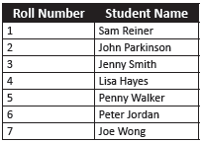
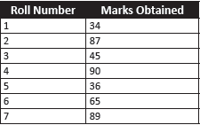
Relational Data Model 3-5
In order to understand the relational model, consider the following Students and Marks tables:
Students Table
Marks Table
The Students table displays the Roll Number and the Student Name, and the Marks table displays the Roll Number and Marks obtained by the students.
To locate students with marks above 40:
First, locate the roll numbers of those who have scored above 50 from the Marks table.
Second, their names have to be located in the Students table by matching the roll number.

Slide 27
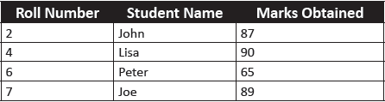
Relational Data Model 4-5
The result is displayed as shown in the following table:
It was possible to get this information because of two facts:
First, there is a column common to both the tables - Roll Number.
Second, based on this column, the records from the two different tables could be matched and the required information could be obtained.
In a relational model, data is stored in tables.
A table in a database has a unique name that identifies its contents.
Each table can be defined as an intersection of rows and columns.

Slide 28
Relational Data Model 5-5
Hides all the complexities of the system and hence it tends to be slower than the other database systems.
Disadvantages of the relational model
Gives the programmer time to concentrate on the logical view of the database rather than being bothered about the physical view.
Advantages of the relational model
Provides querying flexibility and hence the popularity of the relational databases.
Easy to handle model to the extent that even untrained people find it easy to generate handy reports and queries, without giving much thought to the need to design a proper database.

Slide 29
Relational Database Management System (RDBMS) 1-3
Relational Model is an attempt to simplify database structures.
Represents all data in the database as simple row-column tables of data values.
An RDBMS is a software program that helps to create, maintain, and manipulate a relational database.
A relational database is a database divided into logical units called tables, where tables are related to one another within the database.
Tables are related in a relational database, allowing adequate data to be retrieved in a single query (although the desired data may exist in more than one table).
By having common keys, or fields, among relational database tables, data from multiple tables can be joined to form one large resultset.

Slide 30
Relational Database Management System (RDBMS) 2-3
Following figure shows two tables related to one another through a common key (data value) in a relational database:
Thus, a relational database is a database structured on the relational model.
Basic characteristic of a relational model is that in a relational model, data is stored in relations.

Slide 31
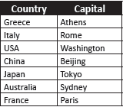
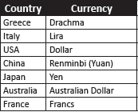
Relational Database Management System (RDBMS) 3-3
Following are the Capitals and Currency tables showing a list of countries and their capitals, and the countries and the local currencies used by them respectively:
Capitals Table
Currency Table
Both the tables have a common column, that is, the Country column.
Now, to display the information about the currency used in Rome, first find the name of the country to which Rome belongs from table Capitals.
Next, that country should be looked up in table Currency to find out the currency.
It is possible to get this information because it is possible to establish a relation between the two tables through a common column called Country.

Slide 32
Terms Related to RDBMS 1-3
There are certain terms that are mostly used in an RDBMS. These are described as follows:
Data is presented as a collection of relations.
Each relation is depicted as a table.
Columns are attributes.
Rows ('tuples') represent entities.
Every table has a set of attributes that are taken together as a 'key' (technically, a 'superkey'), which uniquely identifies each entity.

Slide 33
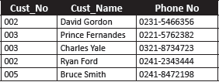
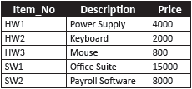
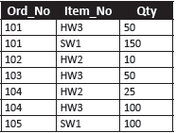
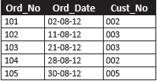
Terms Related to RDBMS 2-3
Consider the scenario of a company maintaining customer and order information for products being sold and customer-order details for a specific month, say, August.
The following tables are used to illustrate this scenario:
Customer
Items
Order_August
Order_Details

Slide 34
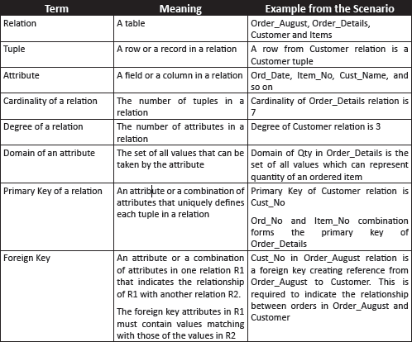
Terms Related to RDBMS 3-3
Following table lists the terms related to tables:

Slide 35
RDBMS Users 1-2
Many persons are involved in the design, use, and maintenance of a large database with a few hundred users.
Database Administrator (DBA)
Database Designer
Collects the information that will be stored in the database
Responsible for identifying the data to be stored in the database
Responsible for authorizing access to the database
Coordinating and monitoring its use
Acquiring software and hardware resources as needed
Accountable for problems such as breach of security or poor system response time
Choosing appropriate structures to represent and store this data
Communicate with all prospective database users, in order to understand their requirements
To come up with a design that meets the requirements
Notes:
Involve: tham gia
Accountable for, responsible for : chịu trách nhiệm
Breach of security: vi phạm an ninh

Slide 36
RDBMS Users 2-2
Design and implement the DBMS modules and interfaces as a software package.
DBMS Designers and Implementers
Determine the requirements of end users
System Analysts and Application Programmers
The end user invokes an application to interact with the system, or writes a query for easy retrieval, modification, or deletion of data.
End User ( là khách hàng )
Develop specifications for pre-determined transactions that meet these requirements
Implement these specifications as programs
Test, debug, document, and maintain these pre-determined transactions
Design, development, and operation of the DBMS software and system environment

Slide 37
Entity
An entity is a person, place, thing, object, event, or even a concept, which can be distinctly identified.
For example, the entities in a university are students, faculty members, and courses.
Each entity has certain characteristics known as attributes.
For example, the student entity might include attributes like student number, name, and grade. Each attribute should be named appropriately.
A grouping of related entities becomes an entity set. Each entity set is given a name. The name of the entity set reflects the contents.
Thus, the attributes of all the students of the university will be stored in an entity set called Student.

Slide 38
Tables and their Characteristics 1-2
The access and manipulation of data is facilitated by the creation of data relationships based on a construct known as a table.
A table contains a group of related entities that is an entity set. The terms entity set and table are often used interchangeably.
A table is also called a relation. The rows are known as tuples. The columns are known as attributes.
Following figure highlights the characteristics of a table:
Notes:
Facilitate: hổ trợ
Tuple: bộ dữ liệu

Slide 39
Tables and their Characteristics 2-2
The characteristics of a table are as follows:
A two-dimensional structure composed of rows and columns is perceived as a table.
Each row (tuple) represents a single entity within the entity set.
Each column has a distinct name.
All values in a column must conform to the same data format.
Each row/column intersection represents a single data value.
Each table must have a key known as primary key that uniquely identifies each row.
Each row carries information describing one entity occurrence.
Each column has a specific range of values known as the attribute domain.
The order of the rows and columns is immaterial in a DBMS.
Notes:
Immaterial: ko đáng kể/ko có ý nghĩa quan trọng

Slide 40
Differences between a DBMS and an RDBMS
^{DBMS(1ng dùng)} | ^{RDBMS(nhiều.ng)}
It does not need to have data in tabular structure nor does it enforce tabular relationships between data items. | In an RDBMS, tabular structure is a must and table relationships are enforced by the system. These relationships enable the user to apply and manage business rules with minimal coding.
Small amount of data can be stored and retrieved. | An RDBMS can store and retrieve large amount of data.
A DBMS is less secure than an RDBMS. | An RDBMS is more secure than a DBMS.
It is a single user system. | It is a multiuser system.
Most DBMSs do not support client/server architecture. | It supports client/server architecture.
Here, entities are given more importance and there is no relation established among these entities. | Here, a relation is given more importance. Thus, the tables in an RDBMS are dependent and the user can establish various integrity constraints on these tables so that the ultimate data used by the user remains correct.
Notes:
Ultimate data: dữ liệu cuối cùng

Slide 41
Summary
A database is a collection of related data stored in the form of a table.
A data model describes a container for storing data and the process of storing and retrieving data from that container.
A DBMS is a collection of programs that enables the user to store, modify, and extract information from a database.
A Relational Database Management System (RDBMS) is a suite of software programs for creating, maintaining, modifying, and manipulating a relational database.
A relational database is divided into logical units called tables. These logical units are interrelated to each other within the database.
The main components of an RDBMS are entities and tables.
In an RDBMS, a relation is given more importance, whereas, in case of a DBMS, entities are given more importance and there is no relation established among these entities.

